Slide 1
Circular Gallifreyan Writer
Trey Smith

Slide 2
Background
Sci-Fi Alphabet
Nested Circles
Sentence – Word – Consonant – Vowel

Slide 3




Slide 4
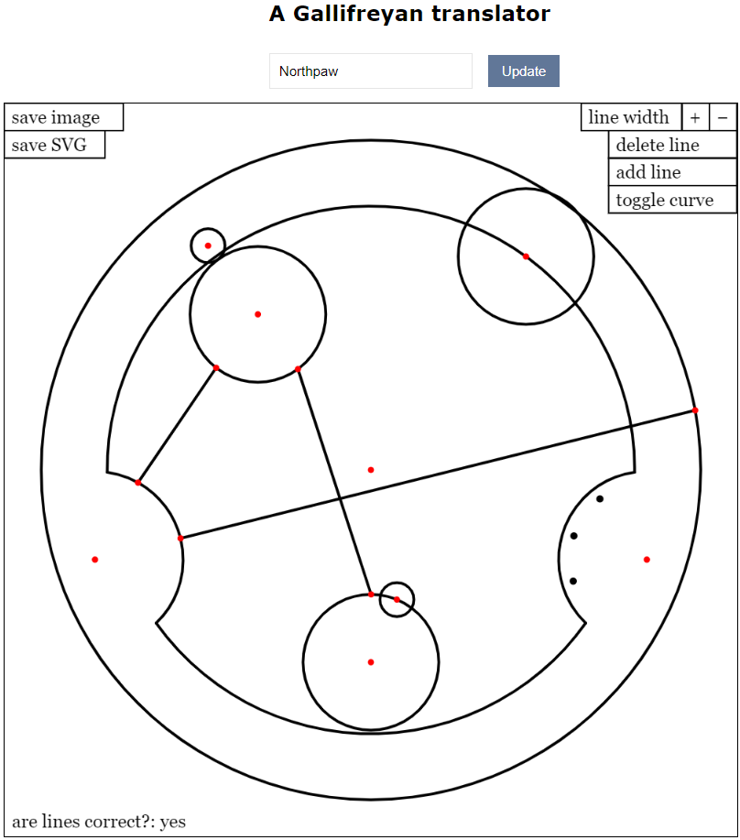
Created with: https://adrian17.github.io/Gallifreyan/

Slide 5
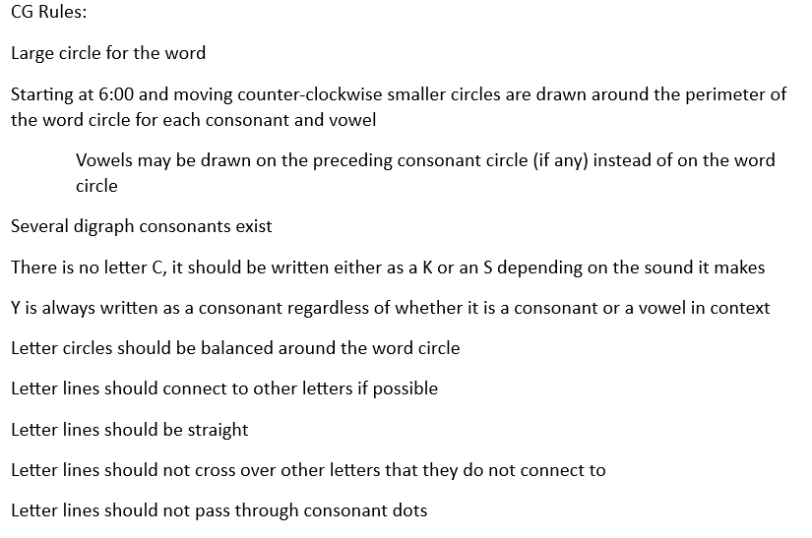
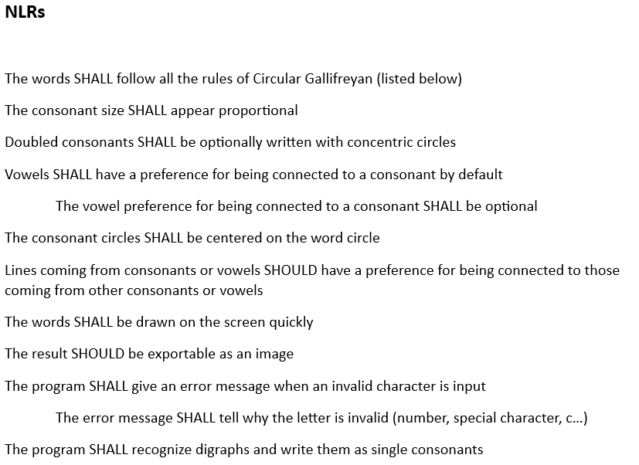

Slide 6
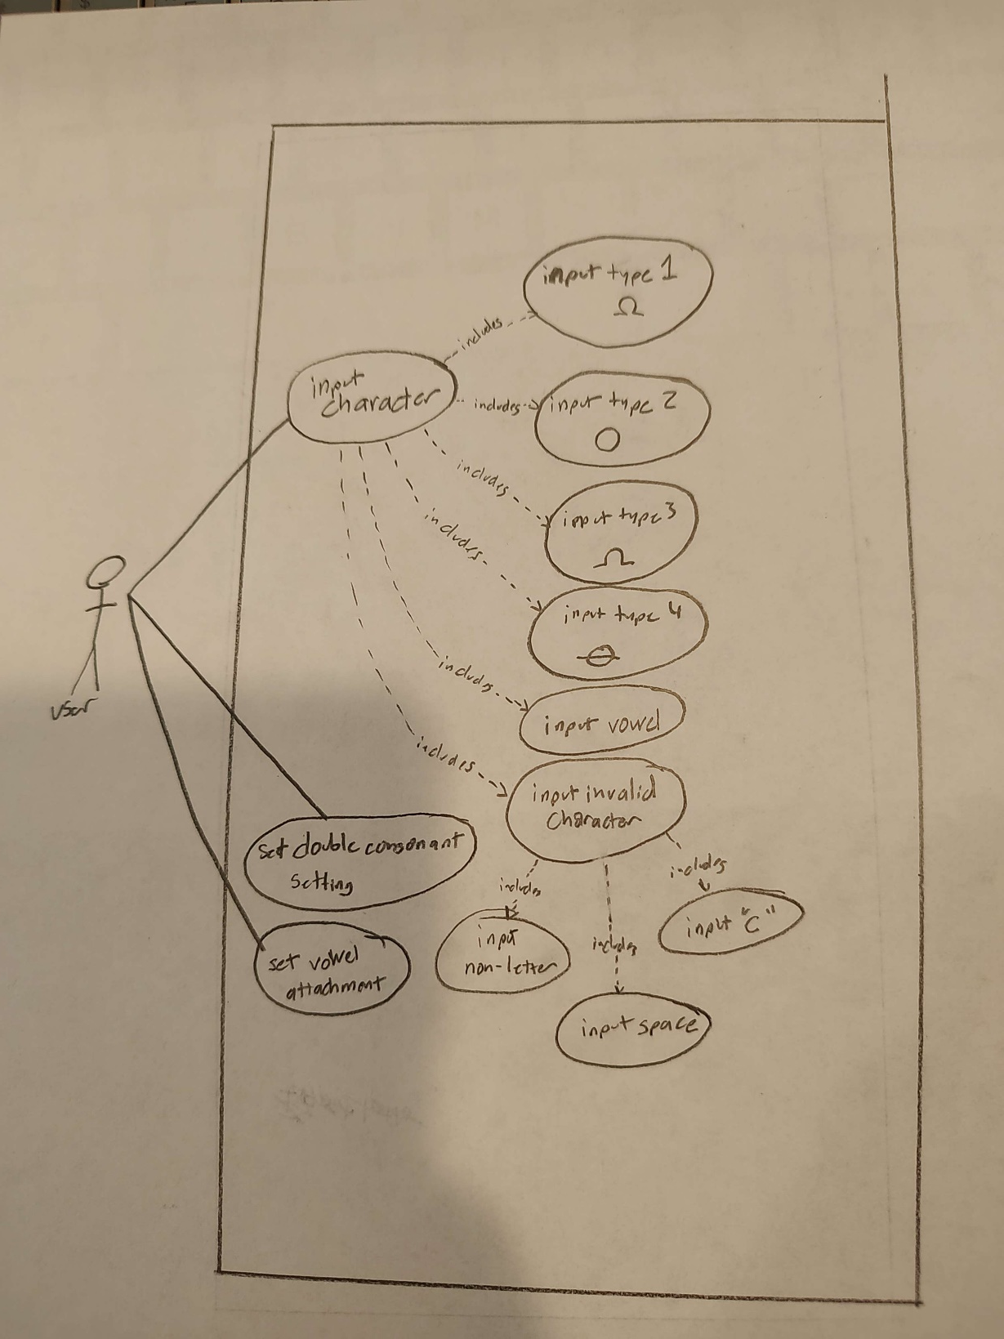

Slide 7
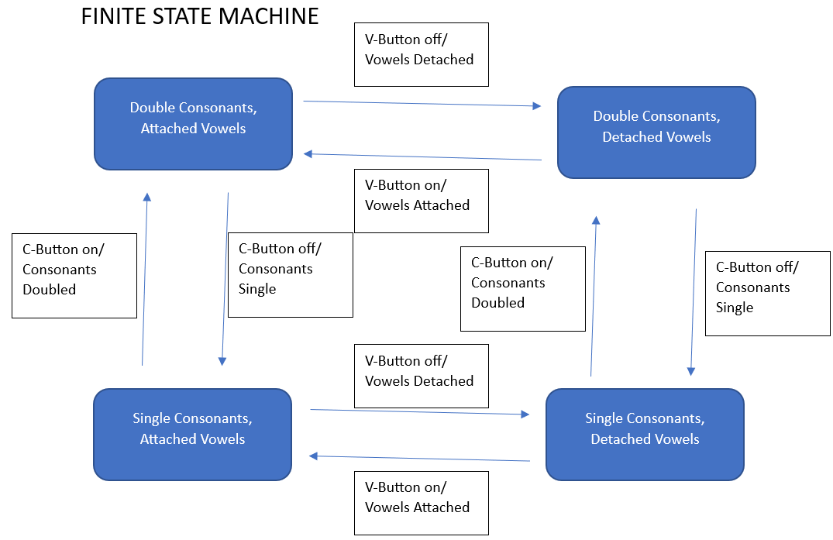
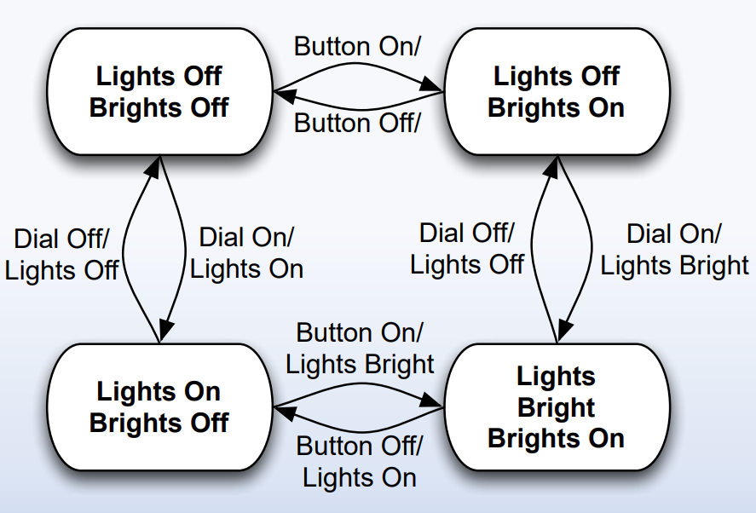

Slide 8
DEMO!!

Slide 9

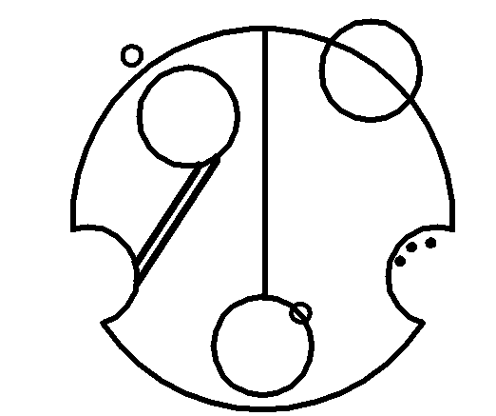
With Tool: ~3 minutes
Manually: ~17 minutes

Slide 10
Future?
REFACTORING!!!
Fine-Tune vowel positions
Redo entire thing with different library (not turtle)

